Slide 1
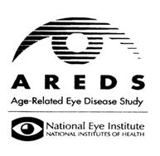
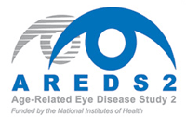
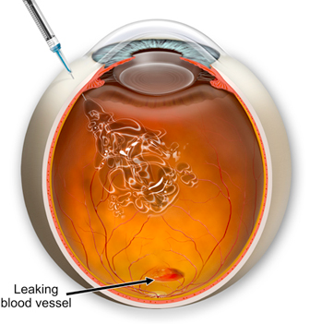
Diagnosis and Current Treatment of AMD
Central Visual Field Defect
BY Rith Narong

Slide 2
Outline
a. Definition
b. Pathogenesis
c. Risk factors
d. Different type and Diagnosis
-DRY
-WET
e. Current Treatment

Slide 3
What is Macular Degeneration?
  =>Is a degenerative disorder affecting the macula that can cause loss of central vision and blindness, in person > 50 years.
  +90% non-exudative (dry) AMD
  +10% neo-vascular (wet) AMD
  => Degeneration: Change of tissue to a less functionally active form

Slide 4
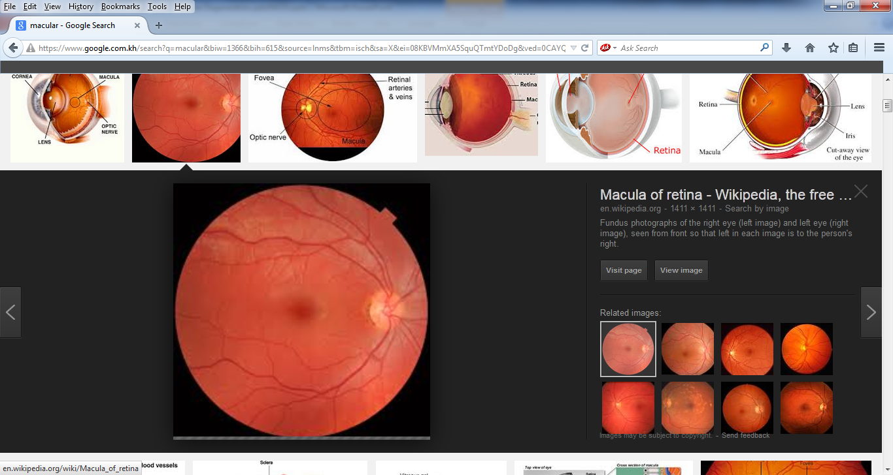
+The macula:round area at the posterior pole, lying inside the temporal vascular arcades. 5 and 6 mm in diameter.
+Has highest concentration of photoreceptors which facilitate central vision and permit high resolution visual acuity

Slide 5
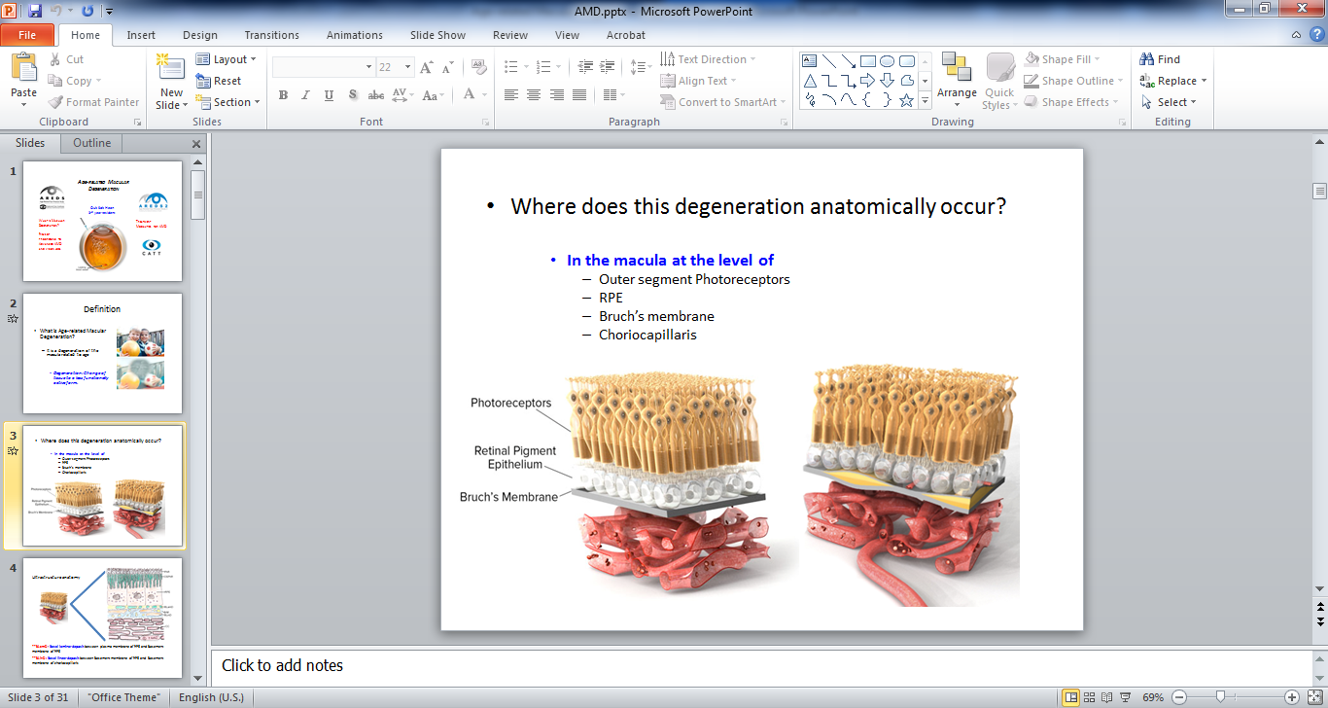
Pathogenesis

Slide 6
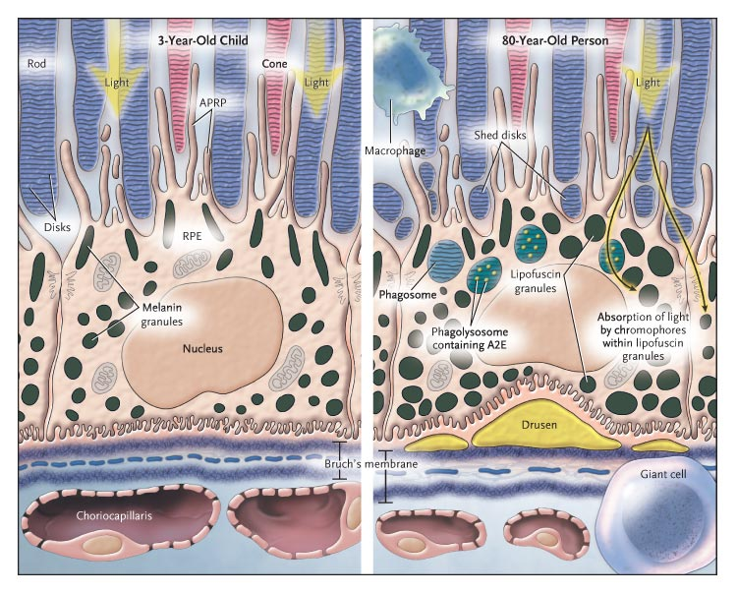
HOW
=>Accumulation reactive debris in RPE
  Inhibits RPE cell function
  Induces RPE cell death
  Bruch’s membrane Thickening

Slide 7
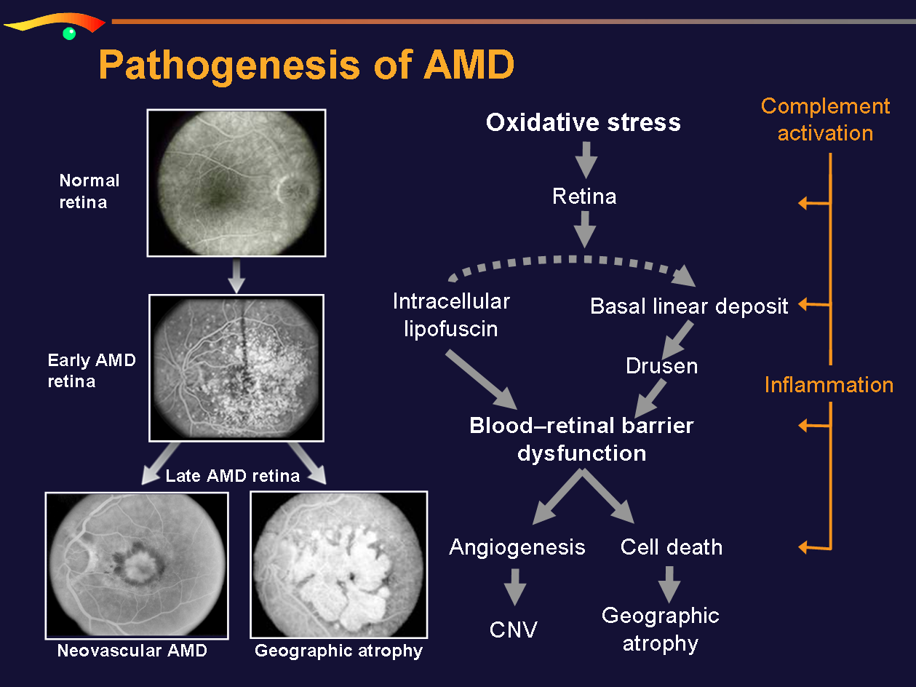

Slide 8
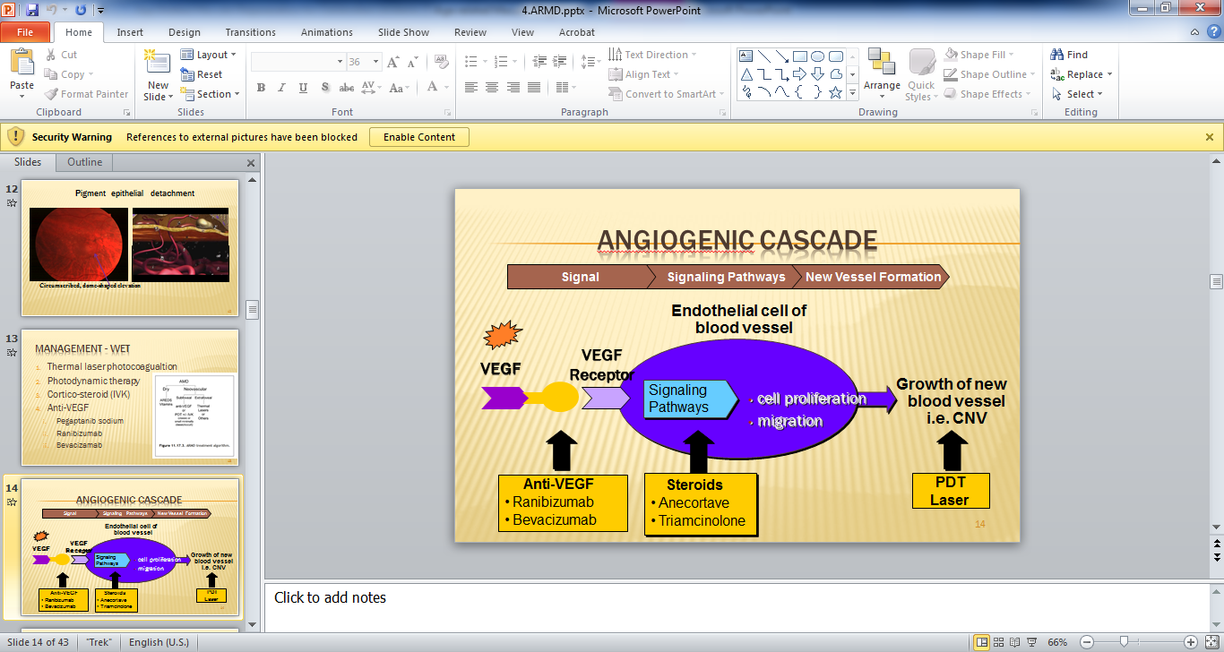

Slide 9
Who Gets ARMD?
=> Age > 50y.o:
+FES:
?65y.o->74 y.o (6,4%)
?>75 y.o (19,7%)
?>80 y.o 6-fold higher Pre.than 60-64y.o
=>Other risk factors for AMD include positive family history, cigarette smoking,Caucasian,hyperopia,
light iris color, hypertension, hypercholesterolemia, female gender, and cardiovascular disease.

Slide 10
#Type and Diagnosis
=>AMD is divided into two main types:
1. Dry AMD (Non-exudative) 85-90%
2. Wet AMD (Exudative) 10-15%

Slide 11
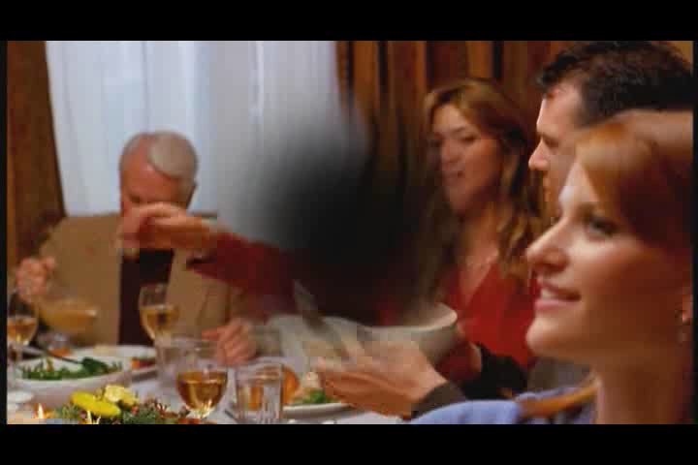
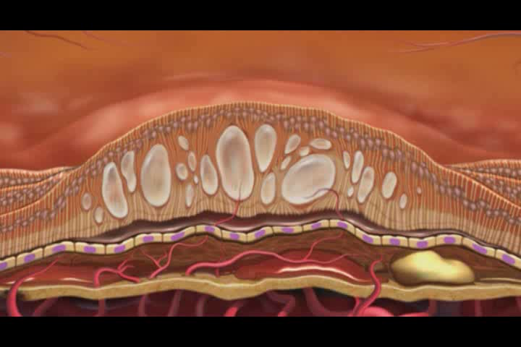
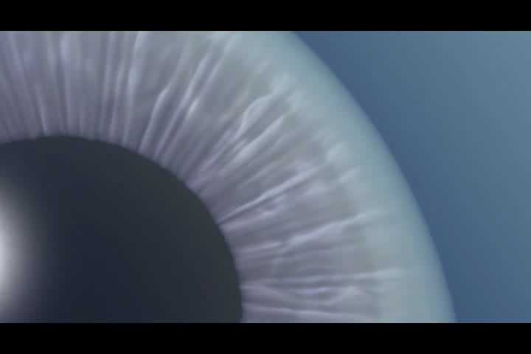
One day I noticed this big, grey blob in the middle of my vision in my left eye.
I knew it wasn’t good.

Slide 12
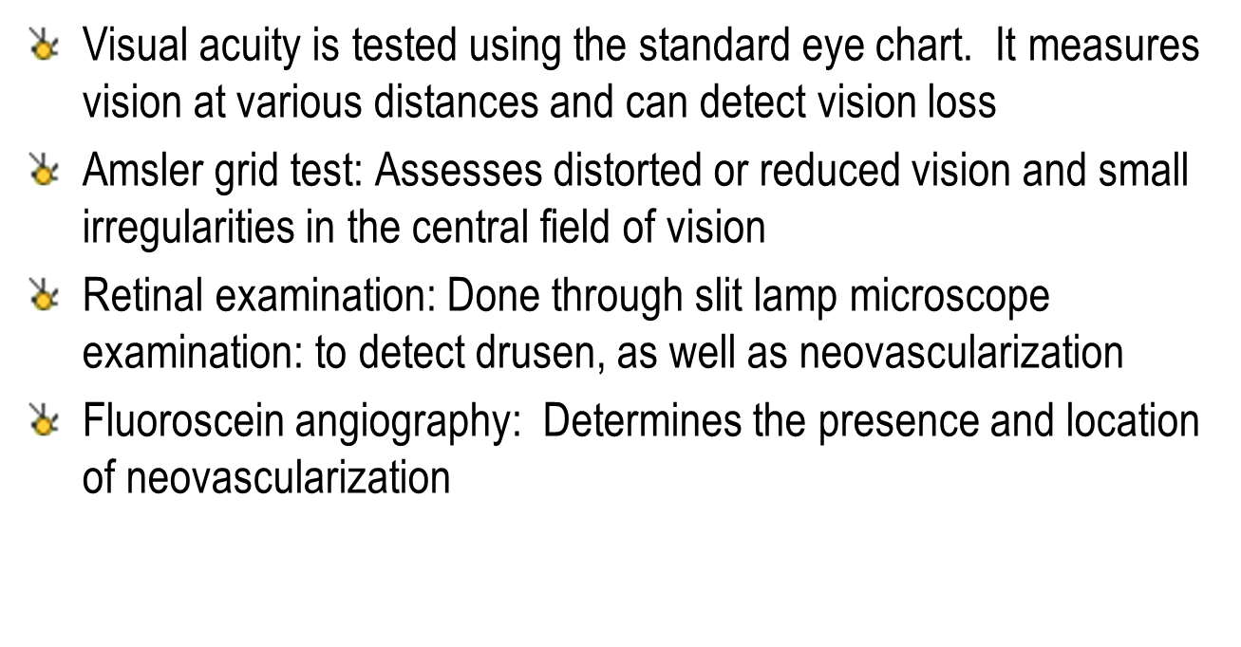
AMD: DIAGNOSIS

Slide 13
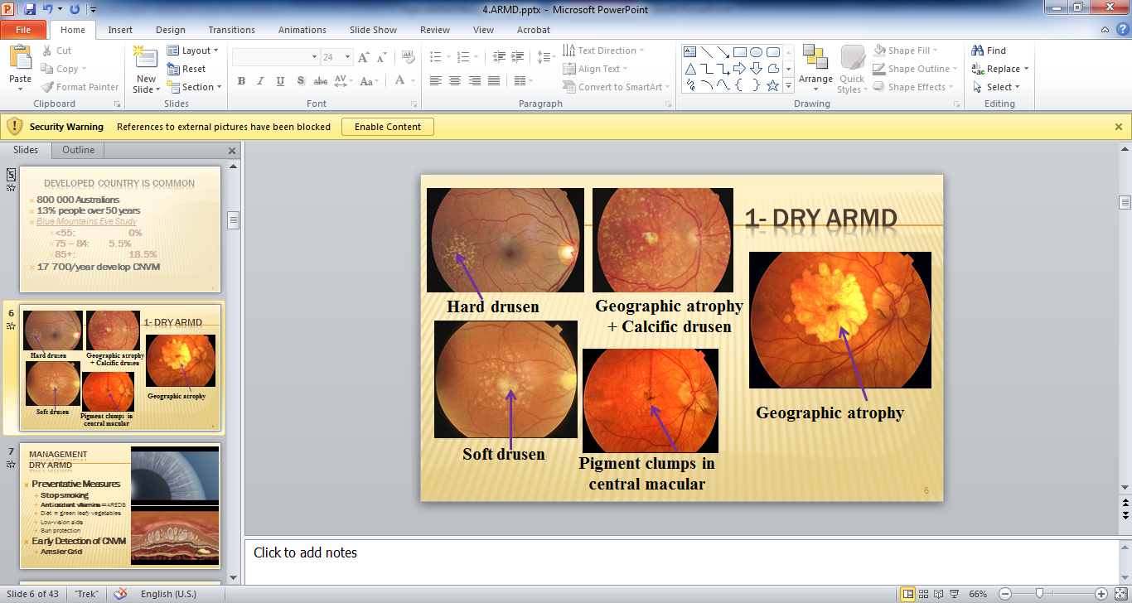

Slide 14
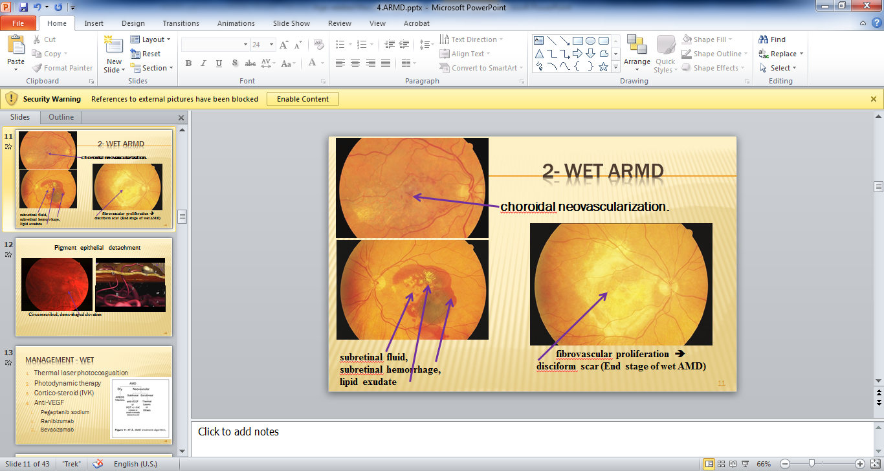

Slide 15
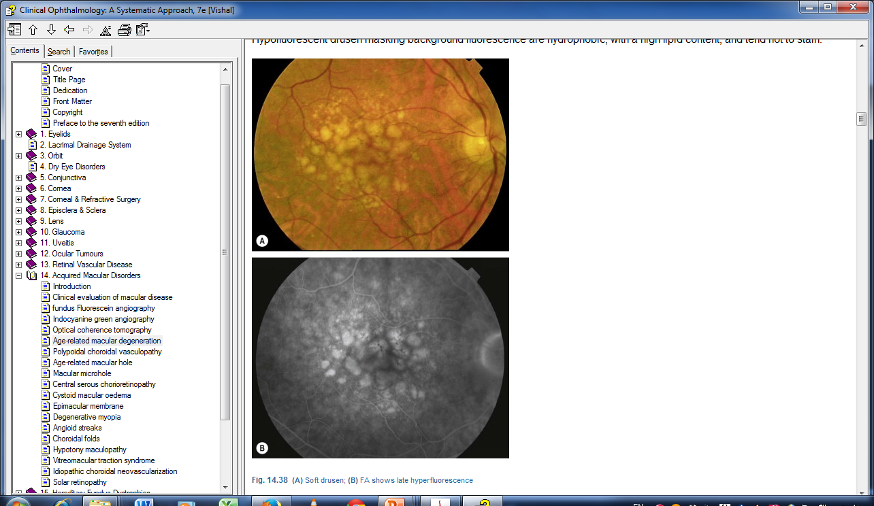
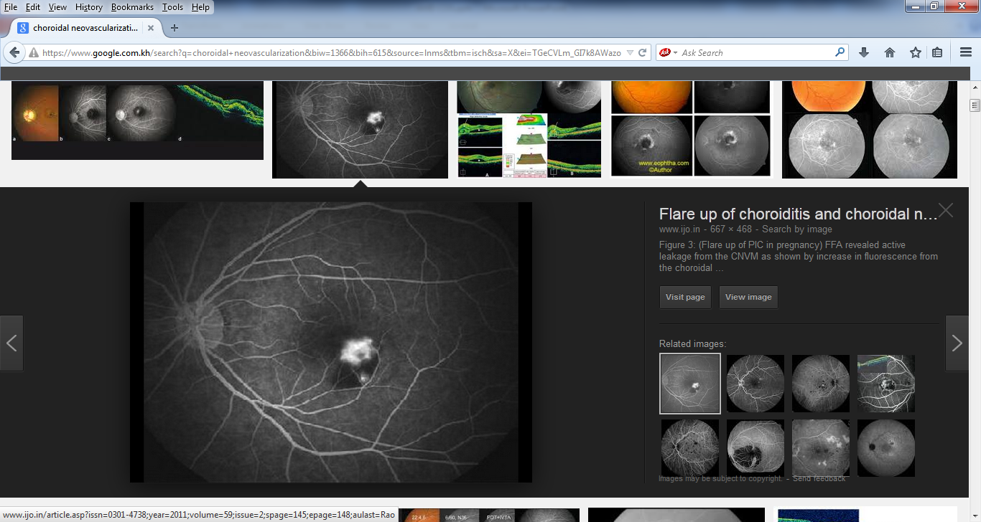

Slide 16
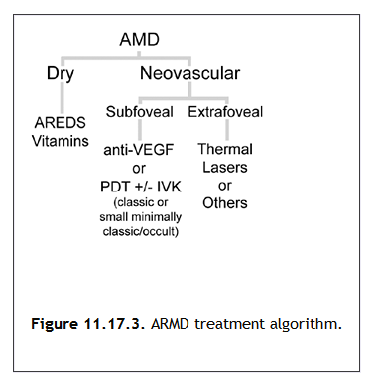
Management

Slide 17
Management Dry ARMD
Preventative Measures
  Stop smoking
  Antioxidant vitamins = AREDS
  Diet = green leafy vegetables
  Low-vision aids
  Sun protection
Early Detection of CNVM
  Amsler Grid

Slide 18
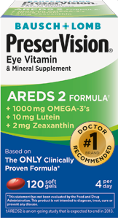
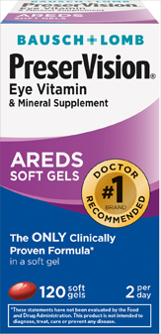
AREDS

Slide 19
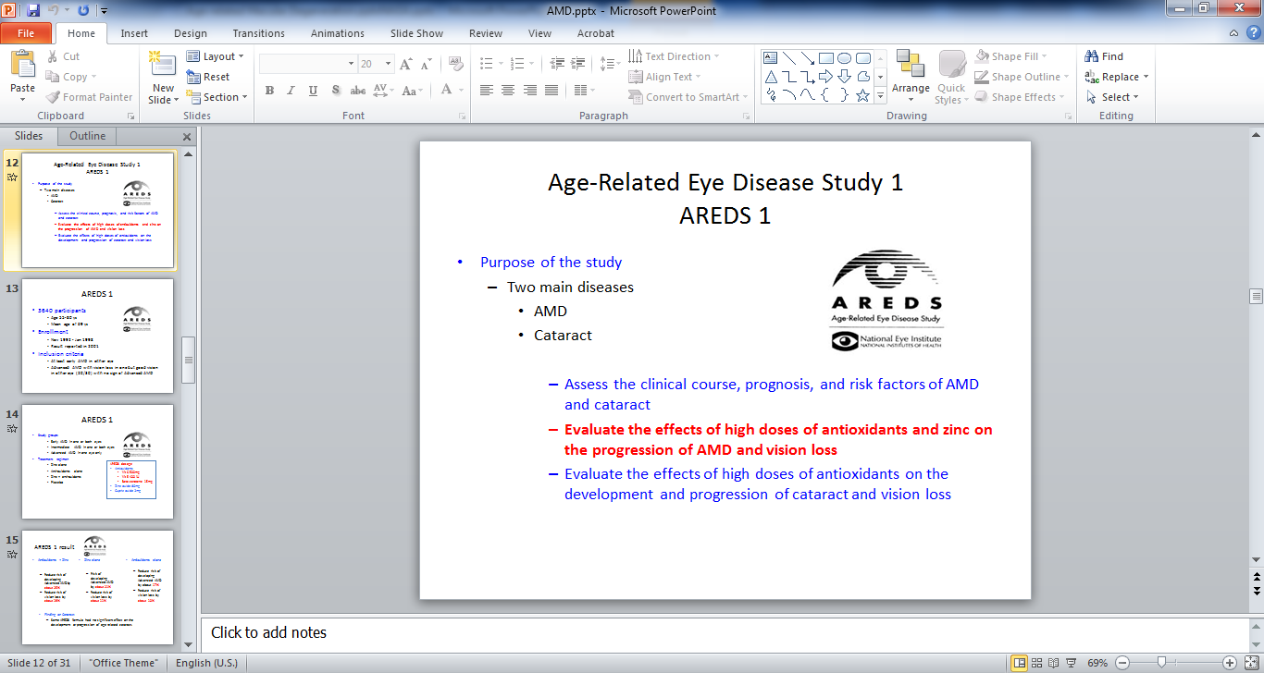

Slide 20
Enrollment
    Nov 1992 - Jan 1998
    Result reported in 2001
Inclusion criteria
    At least early AMD in either eye
    Advanced AMD with vision loss in one but good vision in other eye (20/30) with no sign of Advanced AMD
Study groups
    Early AMD in one or both eyes
    Intermediate AMD in one or both eyes
    Advanced AMD in one eye only
Treatment regimen
    Zinc alone
    Anti-oxidants alone
    Zinc + anti-oxidants
    Placebo
AREDS dosage
Antioxidants
  Vit C 500mg
  Vit E 400 IU
  Beta carotene 15mg
Zinc oxide 80mg
Cupric oxide 2mg

Slide 21
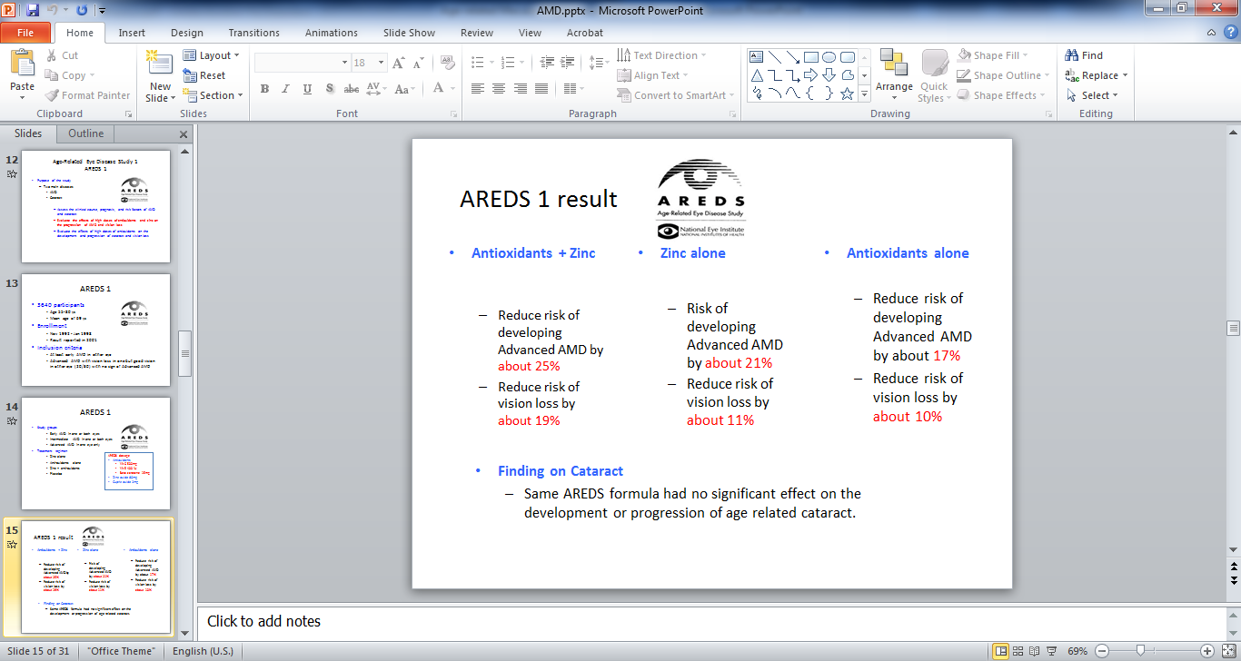

Slide 22
AREDS 1 result
Antioxidants + Zinc
  Reduce risk of developing Advanced AMD by about 25%
  Reduce risk of vision loss by about 19%
Zinc alone
  Risk of developing Advanced AMD by about 21%
  Reduce risk of vision loss by about 11%
Antioxidants alone
  Reduce risk of developing Advanced AMD by about 17%
  Reduce risk of vision loss by about 10%
Finding on Cataract
  Same AREDS formula had no significant effect on the development or progression of age related cataract.

Slide 23
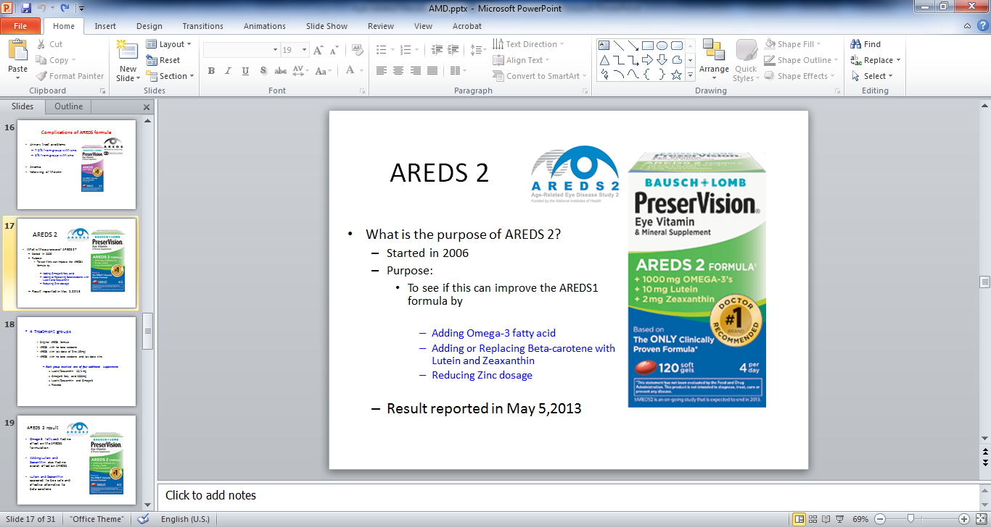

Slide 24
4 Treatment groups
    Original AREDS formula
    AREDS with no beta carotene
    AREDS with low dose of Zinc (25mg)
    AREDS with no beta carotene and low dose zinc
      Each group received one of four additional supplements
        Lutein/Zeaxanthin 10/2 mg
        Omega-3 fatty acid 1000mg
        Lutein/Zeaxanthin and Omega-3
        Placebo

Slide 25
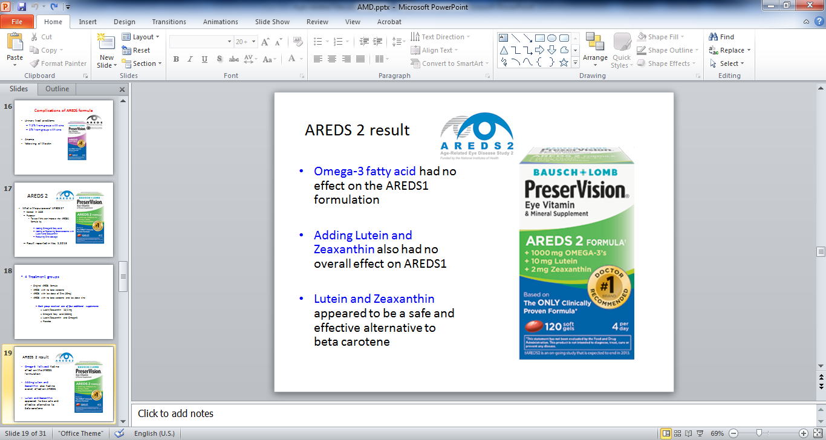

Slide 26
Management - WET
Thermal laser photocoagualtion
Photodynamic therapy
Cortico-steroid (IVK)
Anti-VEGF
  Pegaptanib sodium
  Ranibizumab
  Bevacizamab

Slide 27
THANK YOU FOR
YOUR ATTENTION!!!

